Slide 1
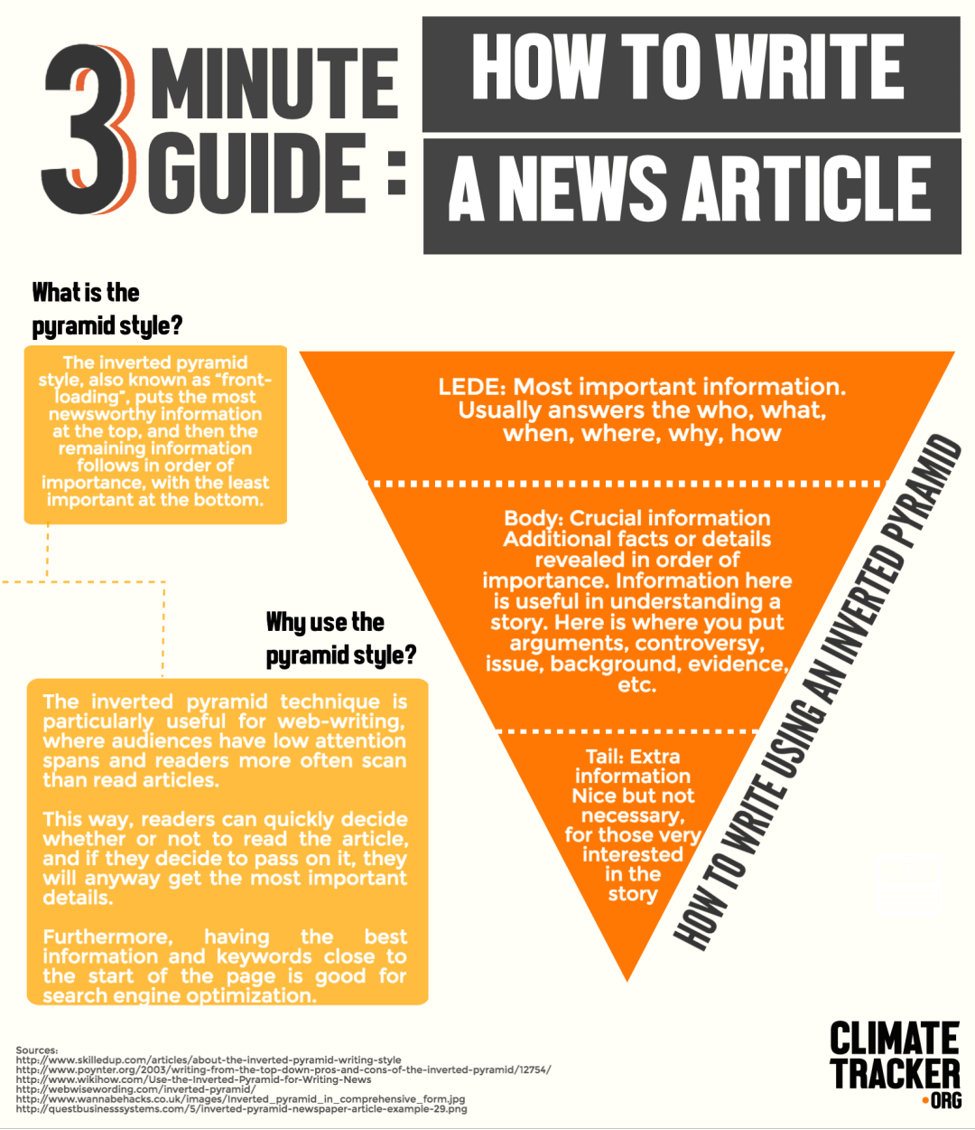
Do We Have A Story?

Slide 2
News From Apple
Apple just announced it will be launching a new product in its iPhone family.
Why would The Penmen Press consider covering it?

Slide 3
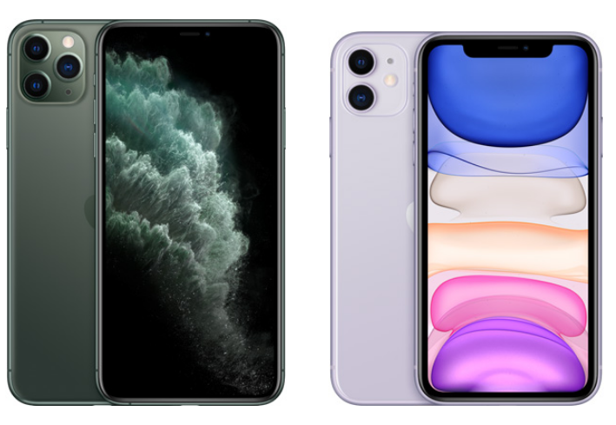
The MiPhone 11T
MiPhone 11T: Same features and specs as 2019’s iPhone 11 and 11 Pro

Slide 4
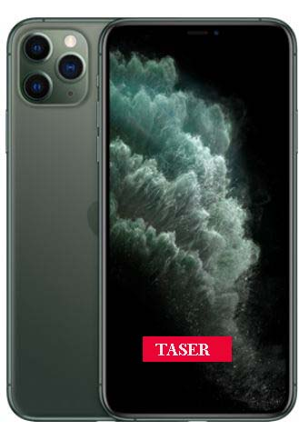
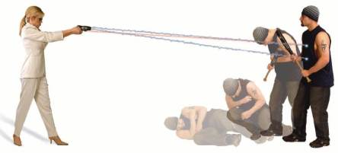
It Adds An Industry First
MiPhone 11T: The first smartphone/mobile communications device with built-in TASER protection

Slide 5
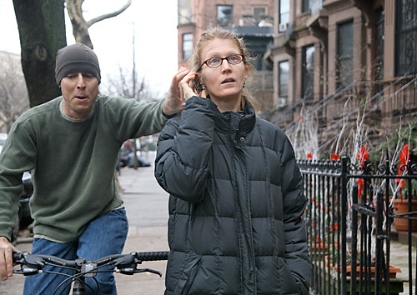
Why Would Apple Do That?
iPhone’s popularity makes them an attractive theft target. By combining them with the safety and self-defense capabilities of a TASER, the new MiPhone 11T protects itself and its owner. It boldly says, “It’s MiPhone. Touch it and I’ll taze you, Bro”

Slide 6
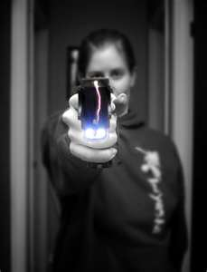
How Does It Work?
TASER technology delivers low voltage of electricity to temporarily disable attacker
Not harmful, no long-term affects or injuries from being shocked. Gives MiPhone 11T user time to escape/flee

Slide 7
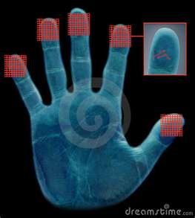
How Does It Work?
Uses separate red “TASER” touch screen button for TASER self-defense
“TASER” button uses biometric fingerprint registration - only the registered owner can fire it

Slide 8
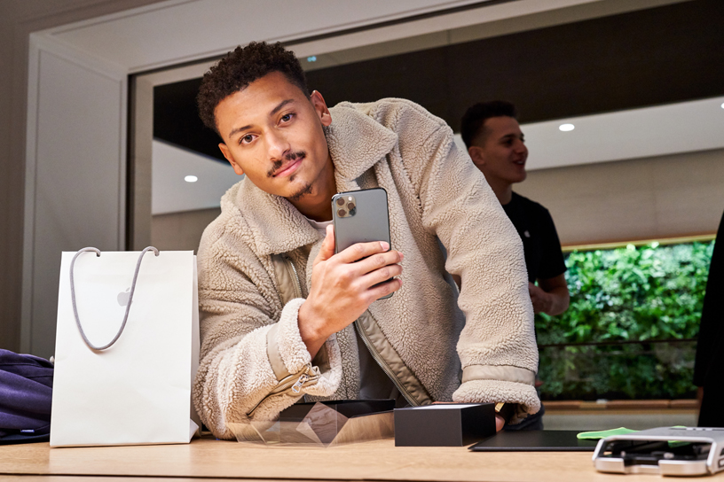
What Else Can It Do?
Same features and specs as iPhone 11 or 11 Pro announced September 20, 2019
https://www.apple.com/newsroom/2019/09/iphone-11-pro-iphone-11-pro-max-iphone-11-and-apple-watch-series-5-arrive-in-stores/

Slide 9
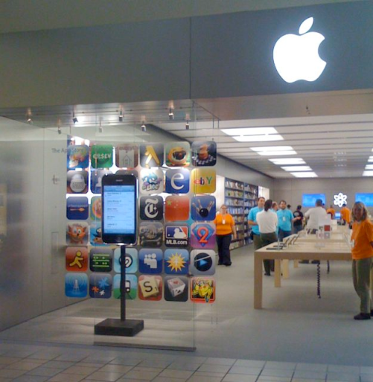
When/Where Can People Buy It?
After 21st birthday – due to weapon status of TASER feature
Users must be aged 21 years or older to purchase and/or register the MiPhone 11T
Available June 1, 2020 at Apple Store®, AT&T, and Verizon retail stores. Not available online
Suggested retail: $1919

Slide 10
What’s Going Into Your Story?
What SNHU-centric stories could the Penmen Press cover?
What readers would care? How might it impact them? What would keep them reading?
Who would you want to interview this afternoon to be able to have a story posted by tomorrow?
Why can’t The Penmen Press run the announcement?

Slide 11
What’s Going Into Your Story?
What do we know about crime on campus? Crime in Manchvegas?
How many of our readers are over 21 and able to buy this?
Does SNHU have any policy about Tasers or weapons on campus?
Are there any dangers of this device in the hands of students? What could possibly go wrong?

Slide 12
What’s Going Into Your Story?
What’s your goal/objective? What’s your story about? Do you have an angle?
What readers would care? How might it impact them? What would keep them reading?
Who would you want to interview this afternoon to be able to have a story posted by tomorrow?
Why would it be crucial to have an accurate and balanced story ready by close of business today?

