Slide 1
What Is A Lead?
The lead, or opening paragraph, is the most important part of a news story. Think Inverted Pyramid

Slide 2
What Is A Lead?
Information overload and short attention spans means your audience won’t read beyond the first paragraph unless you grab their interest

Slide 3
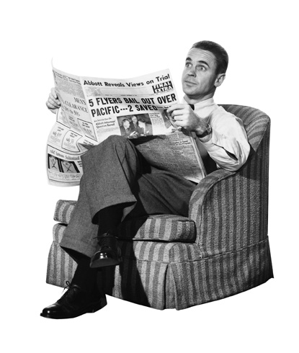
What Is A Lead?
Good leads gives readers the most important information in a clear, concise and interesting manner
It also establishes the voice and direction of an article

Slide 4
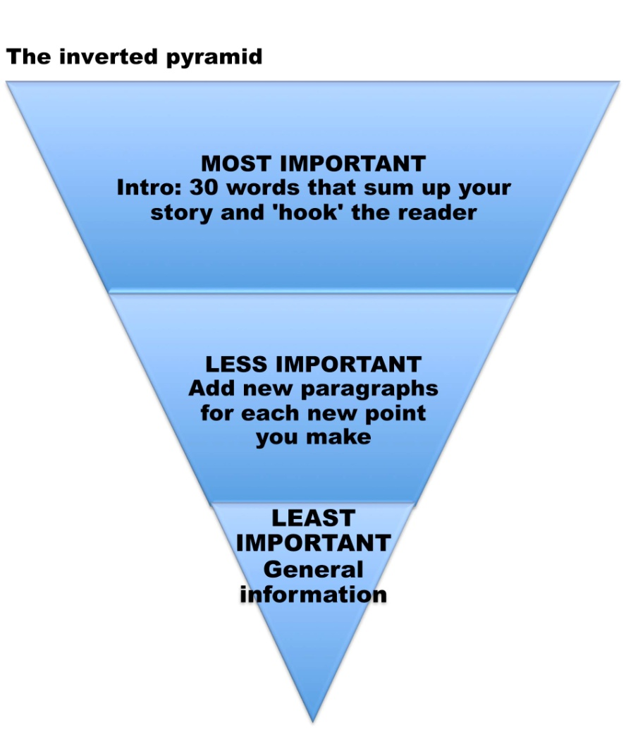
How To Write A Lead
The Five W’s and H: Decide which aspect of the story – who, what, when, where, why, how – is most important
Emphasize those aspects
Less important aspects can wait until 2nd or 3rd sentence/paragraph

Slide 5
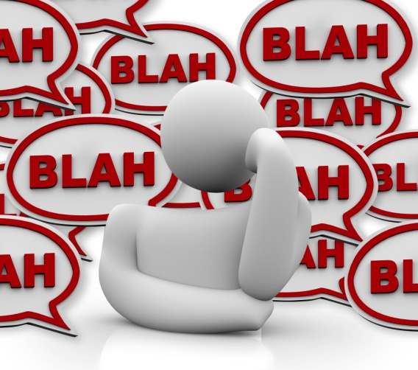
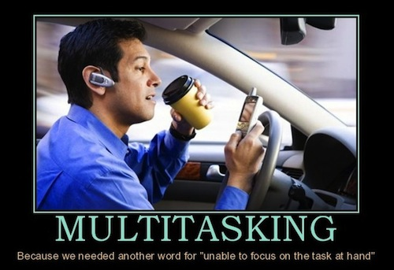
How To Write A Lead
Summarize, but try to be specific
A lead that’s too broad won’t be informative or interesting
Leads are often one or two sentences. Usually about 25 to 30 words -- rarely be more than 40
Readers want to know why the story matters to them. They won’t wait for the answer. Be concise

Slide 6
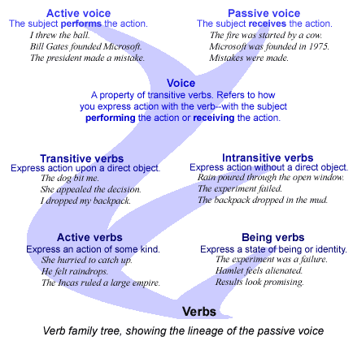
How To Write A Lead
Active sentences: Strong verbs make leads interesting
Passive language is dull and leaves out important information, such as the person or thing that caused the action
Incomplete reporting is often due to passive leads

Slide 7
How To Write A Lead
What does the reader already know? In today’s media culture, most readers become aware of breaking news as it happens
Your lead should do more than merely regurgitate yesterday’s news

Slide 8
Things To Avoid In A Lead
Flowery language: Don’t overuse adverbs and adjectives in the lead. Using strong verbs and nouns
Unnecessary words or phrases: Watch out for unintentional redundancy
I.e: “2 p.m. Wednesday afternoon” or “very unique.” Don’t waste space, especially in the lead. Get to the point
Formulaic leads: Readers want information, but they also want to be entertained. Leads must sound genuine, not just mechanical
It: Don’t start leads with the word “it.” Imprecise and disorients readers

Slide 9
Types Of Leads
Summary lead: Traditional news lead. Often used for breaking news
A story about a student government vote might use this “just the facts” approach
Straight news leads tend to provide answers to the most important three or four of the Five W’s and H
Typically used to convey who, what, when and where

Slide 10
Summary Lead - Example
Lobbyists Flout Disclosure Rules In Talks With Commissioners
By Tony Cook and Michael Mishak for the Las Vegas Sun, July 13, 2008
On more than 170 occasions this year, lobbyists failed to file disclosure forms when they visited Clark County commissioners, leaving the public in the dark about what issues they were pushing and on whose behalf.
Commentary: A good example of the less timely, more analytical approach that some newspapers are taking in their print editions. It covers who, what and when, but also why it matters to readers. Uses active verbs, it is specific (170 occasions) and it is brief (35 words)

Slide 11
Summary Lead - Example
County Administrator Faces Ouster
By Tony Cook for The Cincinnati Post, Jan. 14, 2005
Two Hamilton County Commissioners plan to force the county’s top administrator out of office today.
Commentary: Traditional who, what and when. If this information had been reported on TV or radio the day before, this lead might not be a good one for the print edition of the newspaper. If the reporter posted this information online as soon as it became available, then this lead would make sense. It’s brief (15 words) and uses an active sentence construction

Slide 12
Types Of Leads
Anecdotal lead: Sometimes, beginning a story with a quick anecdote can draw in readers
Anecdote must be interesting and must closely illustrate the article’s broader point
Specificity and concrete detail are essential. The broader significance of the anecdote should be explained within the first few sentences following the lead

Slide 13
Anecdotal Lead - Example
Tri-staters Tell Stories Of The Devastating Tsunami
By Tony Cook for The Cincinnati Post, Jan. 8, 2005
From Dan Ralescu’s sun-warmed beach chair in Thailand, the Indian Ocean began to look, oddly, not so much like waves but bread dough
Commentary: A local angle on the tsunami that struck Southeast Asia. As a result of the massive death toll and worldwide impact, most readers would have been inundated with basic information about the tsunami. Given that context, this lead uses an unexpected image to capture the reader’s attention and prepare them for a new take. It’s brief (23 words)

Slide 14
Question Lead - Example
Same Lobbyist For Courts, Shorter Term, More Money
By Tony Cook for the Las Vegas Sun, June 29, 2008
What’s increasing faster than the price of gasoline? Apparently, the cost of court lobbyists.
District and Justice Court Judges want to hire lobbyist Rick Loop for $150,000 to represent the court system in Carson City through the 2009 legislative session. During the past session, Loop’s price tag was $80,000.
Commentary: Question leads can grab attention, not as clear and concise about providing the main point of a story. In this case, the second paragraph must carry a lot of the weight
JB thinks it looks like advertising copy!

Slide 15
Punctuation
Exclamation points - minimal use or it’s ad copy
Commas - before connecting words that connect two complete thoughts; before and after constrictive clauses. Commas are your friend!
Hyphen - use care and a dictionary
Quotation marks - punctuation ALWAYS goes inside quotation marks
Follow your Writing/Style Guide! If it’s in there, you’re expected to know it!

Slide 16
Headline Writing
Whether it's the title of a release or email subject line, keep it clear, concise, and compelling
Aim for 55 characters or less – leave enough room for a URL and retweeting!
A headline must be:
Unique. What's so different about your news?
Urgent. Why does your news matter to me right now?
Useful. How will your news help me?
Unambiguous/specific. What can I learn just from the headline?
Source: http://www.ragan.com/Main/Articles/How_to_write_great_headlines_in_55_characters_or_f_46030.aspx#

Slide 17
Headline Writing
Let's try one: SNHU is going to feature a Cardi B and Post Malone tribute band at SNHUstock
You could write a fairly bland headline like:
SNHUstock Coming March 23

Slide 18
Headline Writing
SNHUstock Coming March 30
Is it unique? Maybe. It's hard to tell
Is it urgent? Definitely not
Is it useful? Maybe, maybe not
Is it unambiguous? Again, maybe, maybe not. It depends on whether the words mean anything
to you
Can you tweet it? Yes, but who cares?

Slide 19
Headline Writing
Post Malone And Cardi Tributes To Headline SNHUstock
Unique? How many schools get Posty and Cardi?
Urgent? Not quite – how do we know when it is or why we need to buy now?
Useful? Sort of – we know the names
Unambiguous? Well, it might compel you to start reading
It also came in at 52 characters, just under the 55-character recommended limit.
Source: http://www.ragan.com/Main/Articles/How_to_write_great_headlines_in_55_characters_or_f_46030.aspx#

Slide 20
Headline Writing
CAPE Announces Revolutionary New Tribute Bands Performing at SNHUstock!
Unique? Maybe, but does it tell readers anything?
Urgent? No
Useful? Definitely not
Unambiguous? Not at all
This is a failed headline – too long, useless, and hype thanks to the exclamation point
Source: http://www.ragan.com/Main/Articles/How_to_write_great_headlines_in_55_characters_or_f_46030.aspx#

Slide 21
Headline Writing
“Ticket For Post Malone And Cardi B Tributes At SNHUstock March 30 Available Now”
Unique? Yes.
Urgent? Yup – we know it’s time to get tickets
Useful? Unquestionably
Unambiguous? Yup – time to read and buy
Character count: 81 (a bit much)
Source: http://www.ragan.com/Main/Articles/How_to_write_great_headlines_in_55_characters_or_f_46030.aspx#

Slide 22
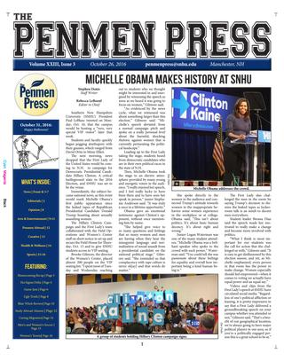
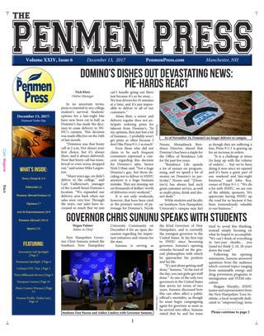
Headline Writing
The best headlines help readers start creating a story in their heads or inspire a question in their minds that compel them to want to read more

