Slide 1
Let’s Talk about leads

Slide 2
What is a lead?
The first paragraph/beginning of an article
Gives the reader the most important information
Gives clear evidence to what the article will be about
Concise
Makes the reader want to continue reading

Slide 3
Hook the reader
\
This is the ultimate goal of each lead

Slide 4
Examples of Good Ledes

Slide 5
Two SNHU athletes made history when they reached the final of the Intercollegiate Tennis Association (ITA) Championships at the Billie Jean King Tennis Center in New York. Bas and Willem van Biezen met in the ITA championship match on September 16 in what was the biggest match of their ever-growing careers.

Slide 6
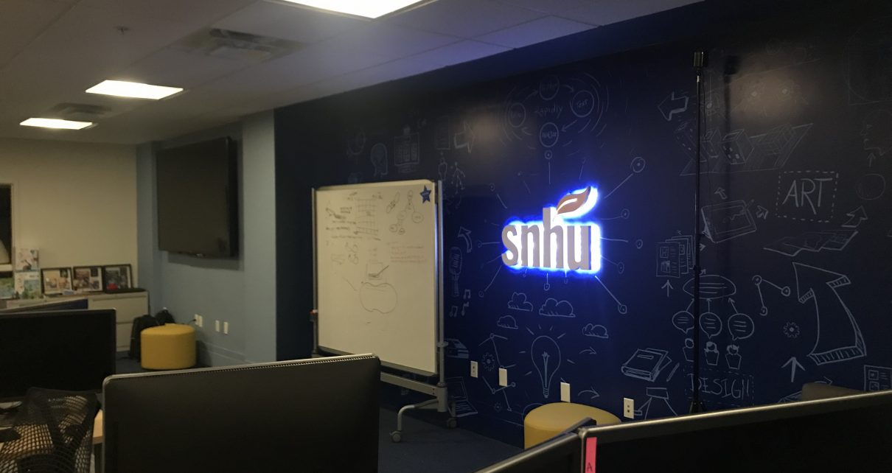
By using a 360-degree camera in the Inkwell Interactive Studio, students recently built a Virtual Reality (VR) campus tour that is displayed on an Oculus Go, a standalone VR headset. Potential students visiting SNHU booths at college fairs can experience the campus from anywhere in the world.

Slide 7
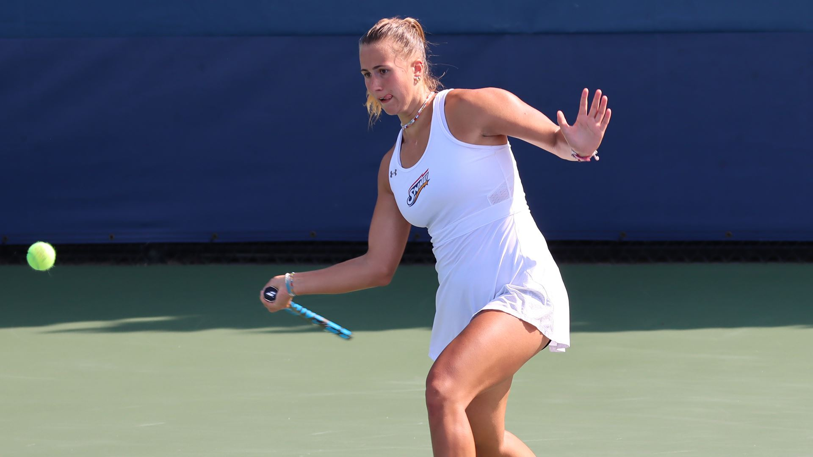
Magdalena Hubickova (’23), who hails from Prague, the Czech Republic, is taking the SNHU women’s tennis team by storm.

Slide 8
Time to Take Lede
Get In Groups
Last week we came up with article ideas, refresh on these ideas with your group. Feel free to share any topics you’re writing about!
Create Ledes
Everybody takes a topic and comes up with a lede. Each person should have their own lede, but work with your group to make sure it’s effective
Share Your Lede
When we’re done with groups we will all share our ledes! This time we won’t compete, but make sure to listen to what your peers use that makes you want to know more

Slide 9
Time for Sections!

