Slide 1
Happy Groundhog day!
Did he see his shadow?

Slide 2
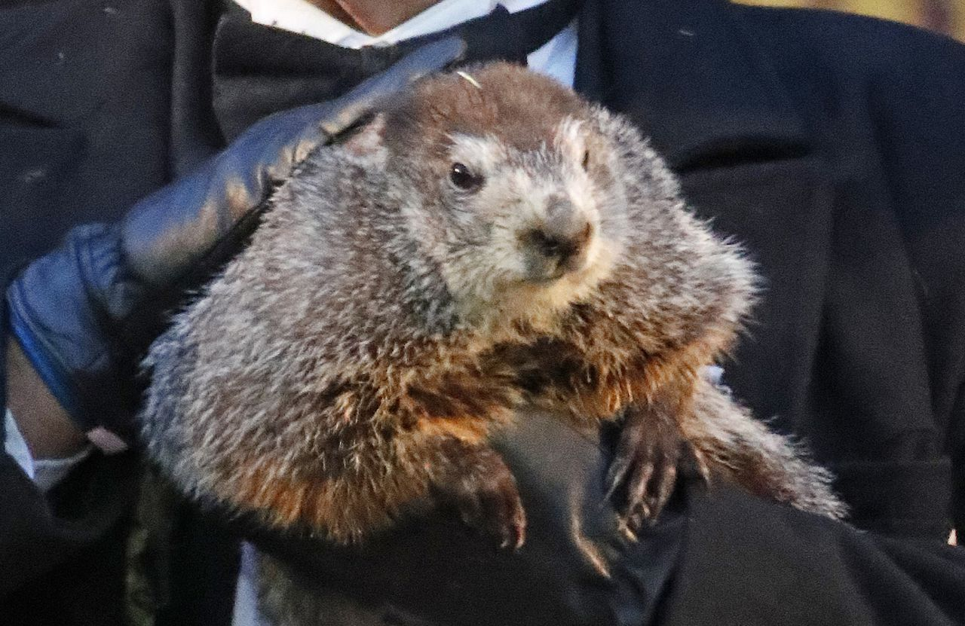
Announcements:
Online Issue
Advertising
Socials
Events
Staff bonding
Articles due today & assigned
Articles due to copy 2/4
Next print issue distributed 2/11/22 (combo of this issue and next)

Slide 3
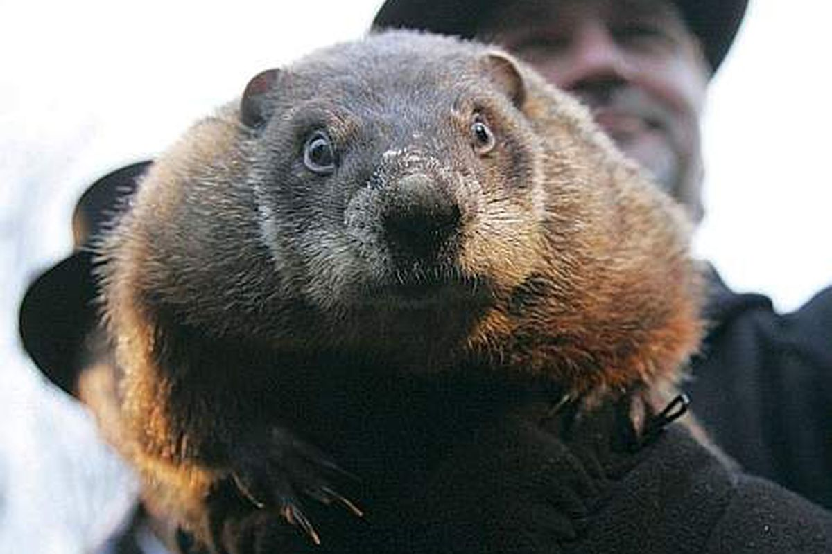
What do you need from us?
It’s been almost a month → What has worked? What hasn’t? How can we help you produce your best possible work?
Let's brainstorm! What do you think will be helpful to see in meetings?

Slide 4
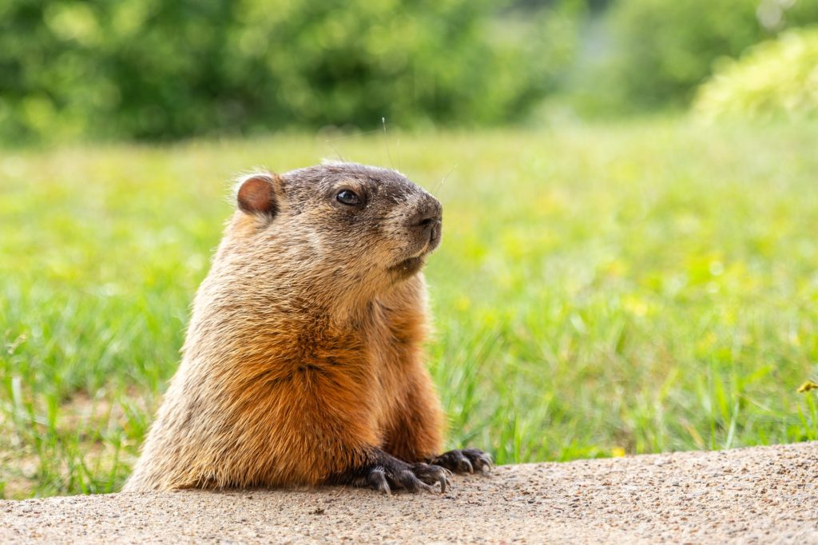
Interviewing 101
Almost every article should have at least two sources, and hopefully more!
Each article will require different sources, but they should all connect to SNHU!
Notes:
You can safely remove this slide. This slide was provided by PoweredTemplate.com – You can download more templates, shapes and diagrams for presentations from https://poweredtemplate.com

Slide 5
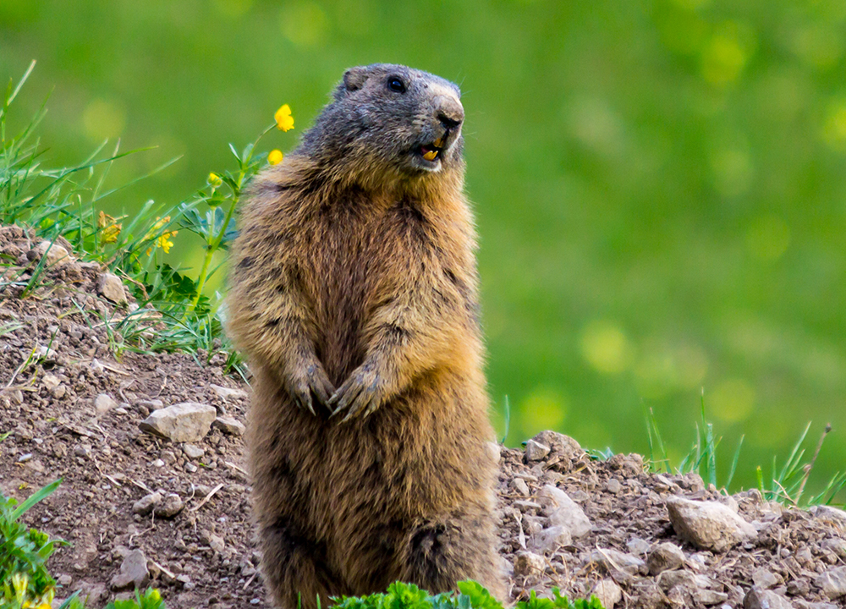
How to set up an interview
Who should you interview?
If a story focuses around the school/higher ed seek out a staff/faculty member in the appropriate department
Stories about campus life are a great opportunity to talk to students - you can’t use people you know as sources, but it’s a great opportunity to branch out and meet more of the SNHU community

Slide 6
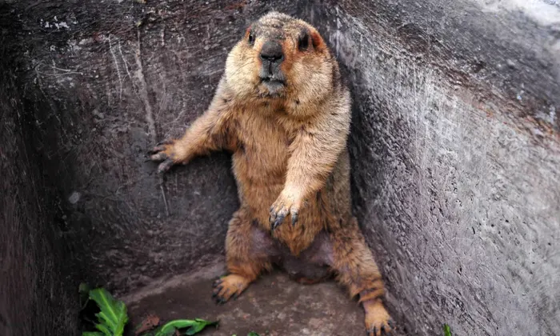
How do you set up an interview cont…
Email staff/faculty, students, or athletes to set up an in person or virtual meeting
Try to be as flexible as possible with times, and prepare for a longer interview
Talk to students in common areas - it may feel awkward but that’s the best way to hear from the community!

Slide 7
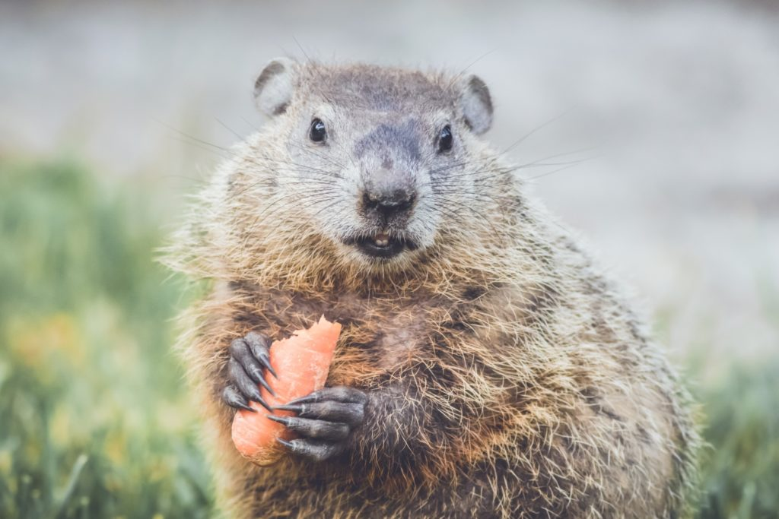
Interview Prep
Think about why you’re interviewing this person - what do they know that you to know?
Try to come up with at least ~10 questions → More questions = more information for the story
Be prepared to go off script! You could get information you didn’t even know you wanted!
Dress professionally! You don’t need a tux, but show you appreciate this person taking time to talk to you!

Slide 8
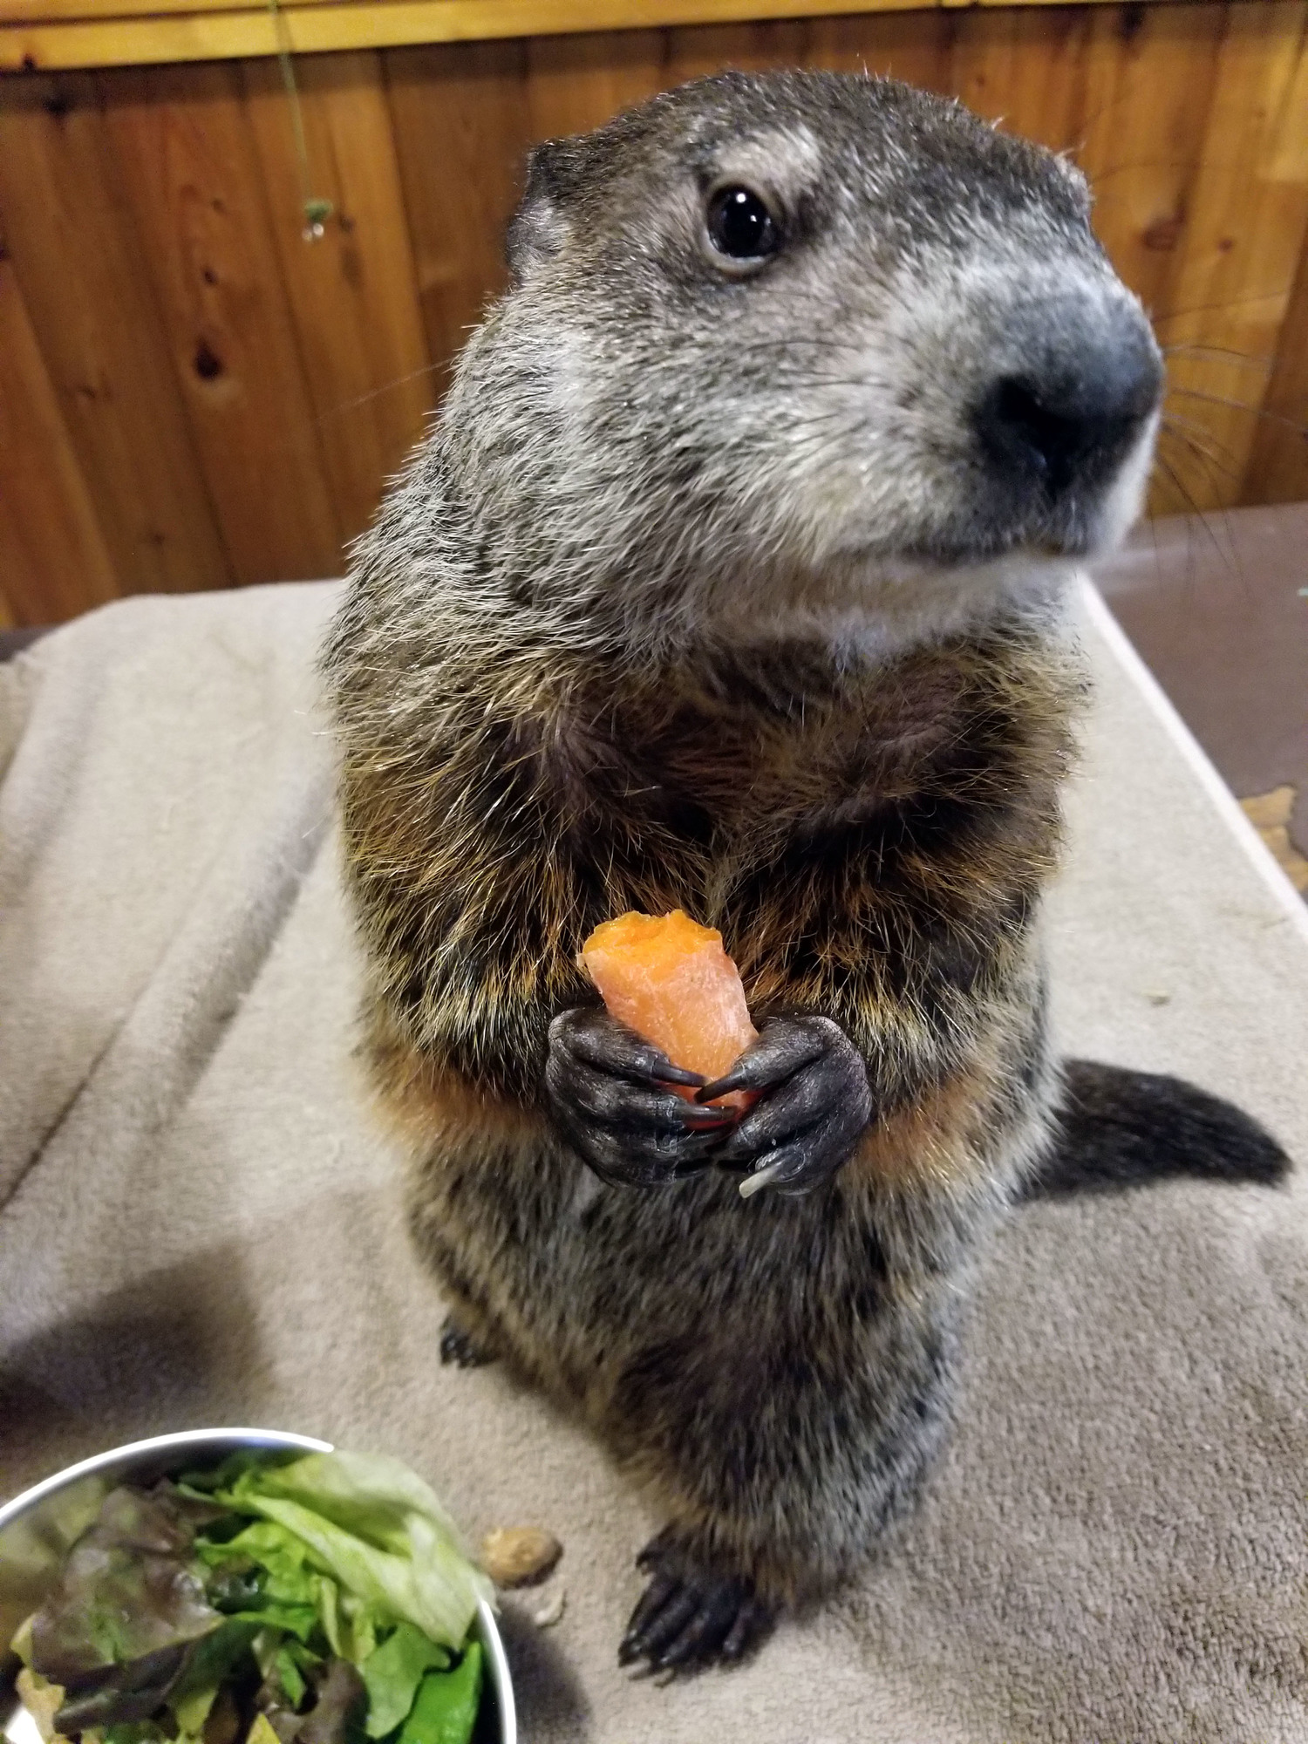
Conducting the interview
Record the interview and take notes!!
Make sure you get their name, pronouns, and consent to recording on the audio recording!
There are many note taking strategies, but notes are a must!!
Make sure to ask follow up questions! It makes the subject feel heard and more comfortable, and gets you more info for your article
Remember that your subjects are people too! Don’t be stressed and don’t rush to change the conversation if it strays!

Slide 9
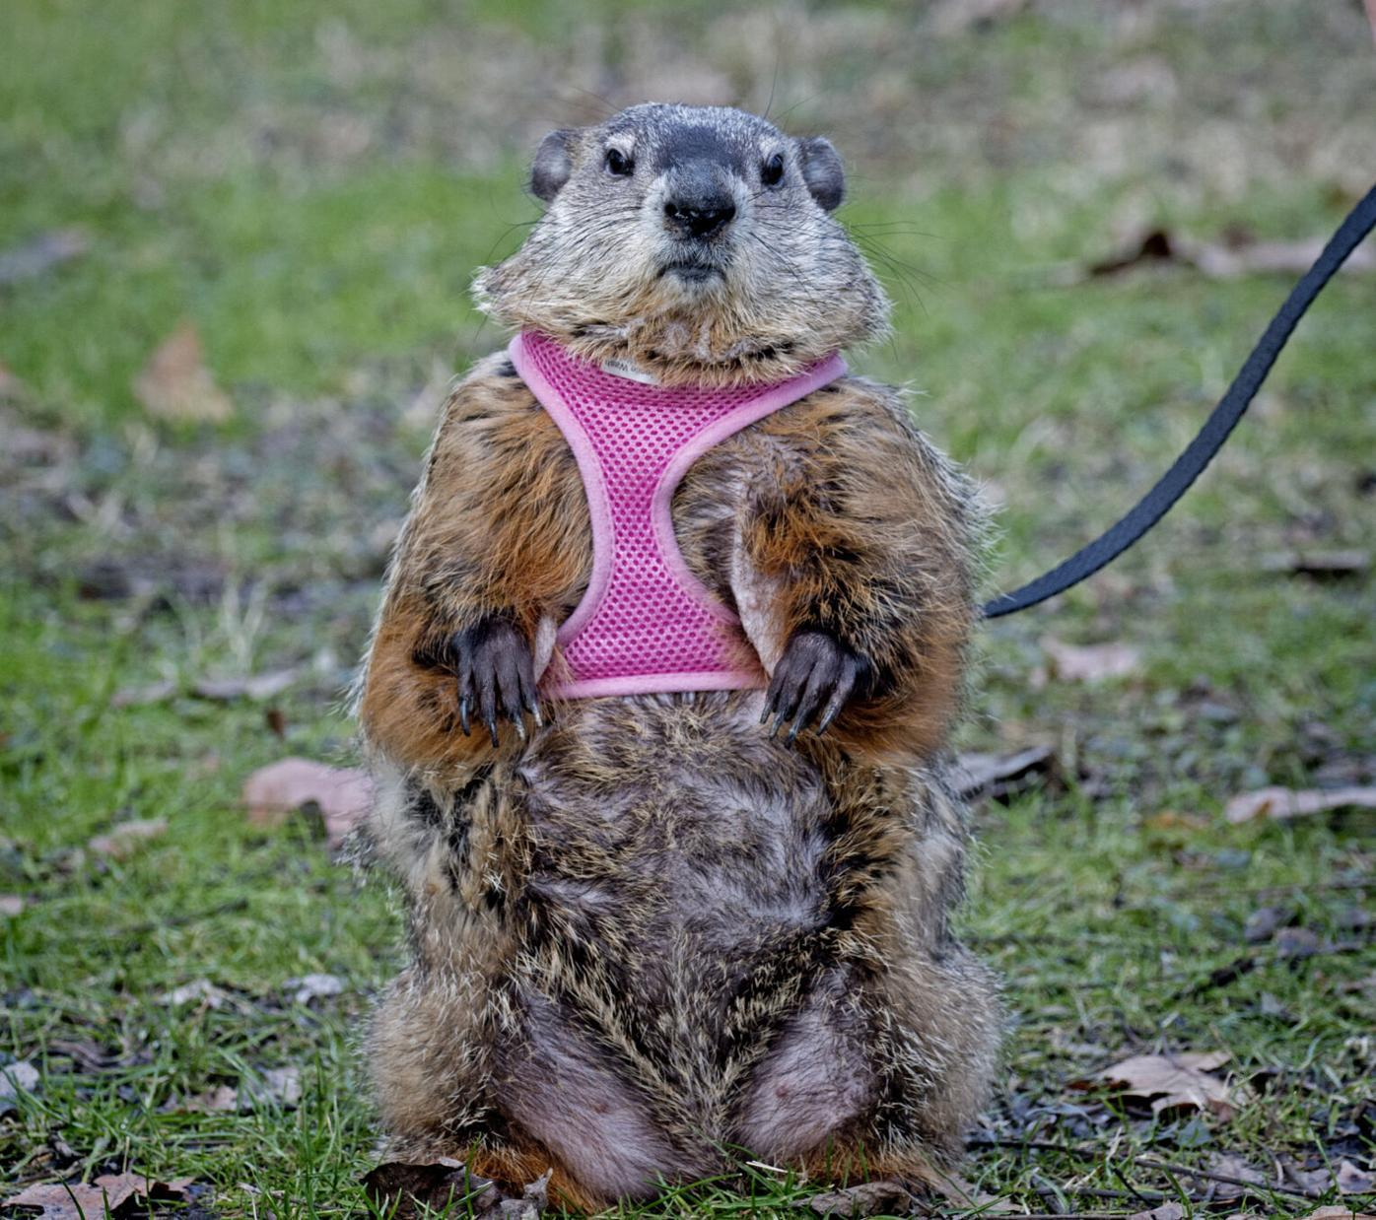
After the interview
MAKE SURE YOUR SUBJECT’S NAME IS SPELT CORRECTLY
MAKE SURE PRONOUNS AND GRAD YEAR ARE CORRECT
MAKE SURE THE QUOTE IS ACCURATE
If you relisten and don’t understand something or have more questions reach out to your subject! It’s better to be sure than to publish an inaccuracy!
Repeat as many times as necessary!

Slide 10
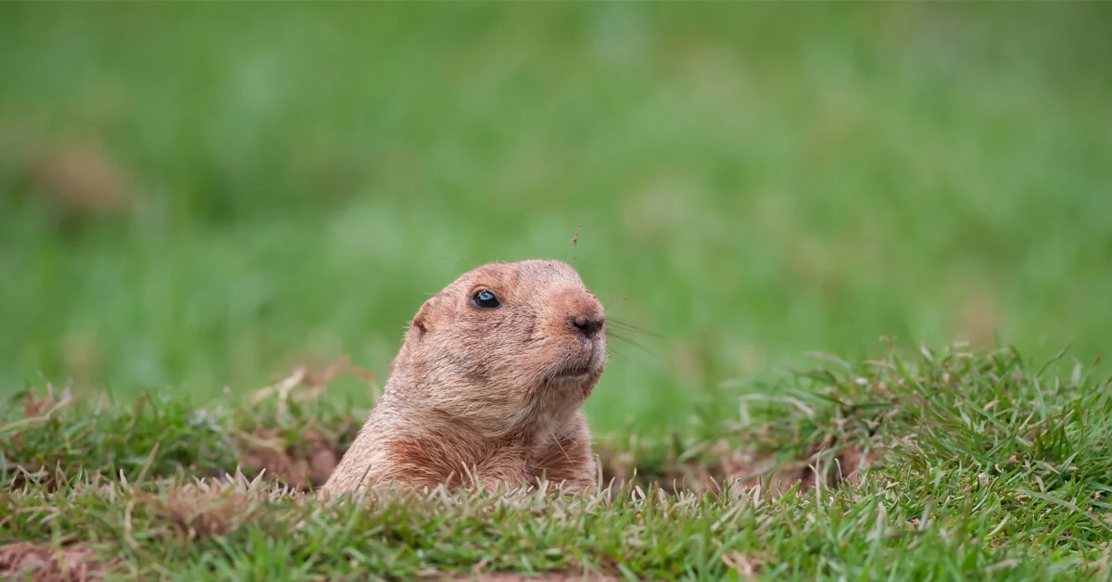
Any article ideas?
Our article scheduling should be up on the info page!!
Article brainstorm session!!

Slide 11
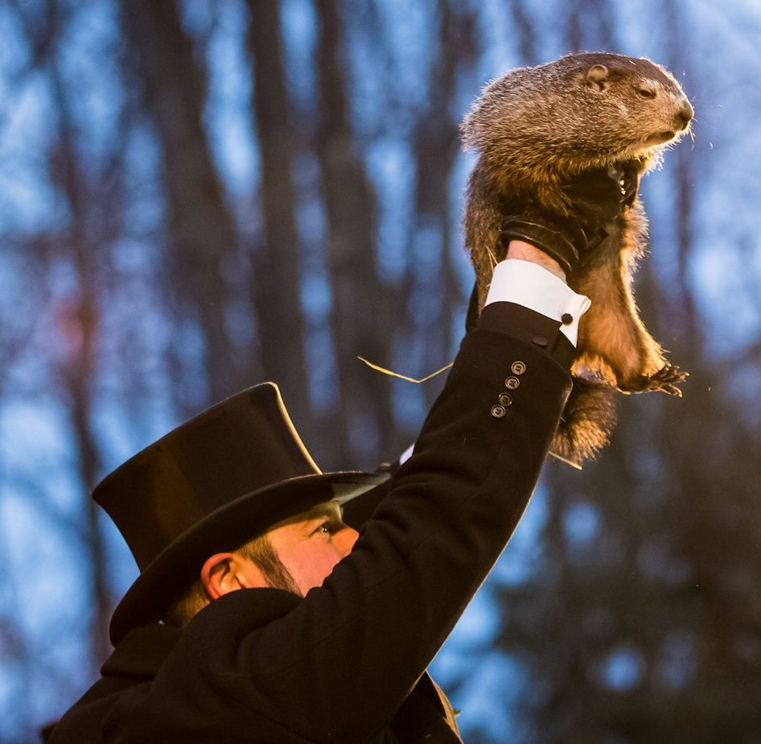
Time to work on articles, meet with editors/managers
Talk about what you need to improve on
Finish articles for next week's issue
Articles were due today…discuss needs for them
Ask us any questions

